Slide 1
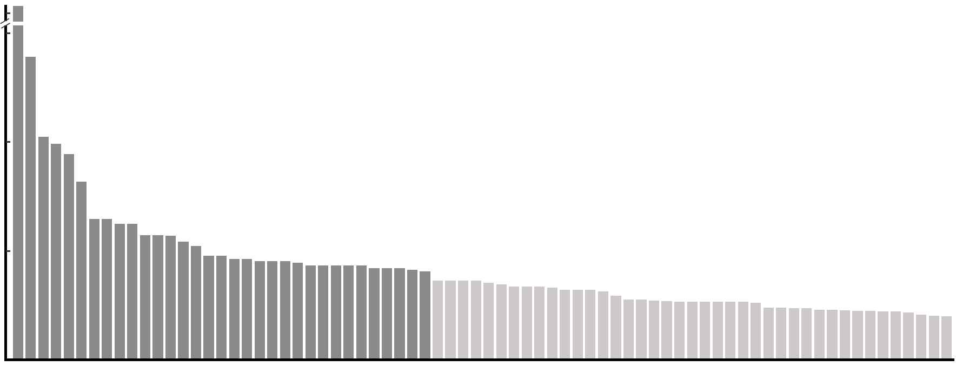
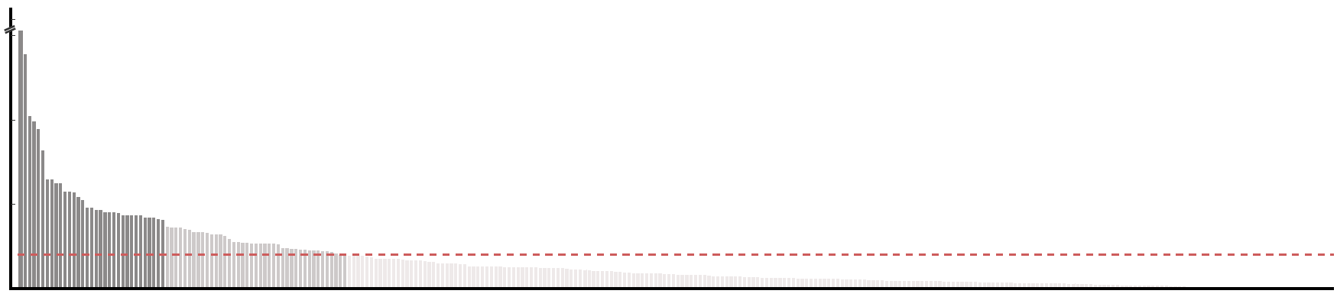
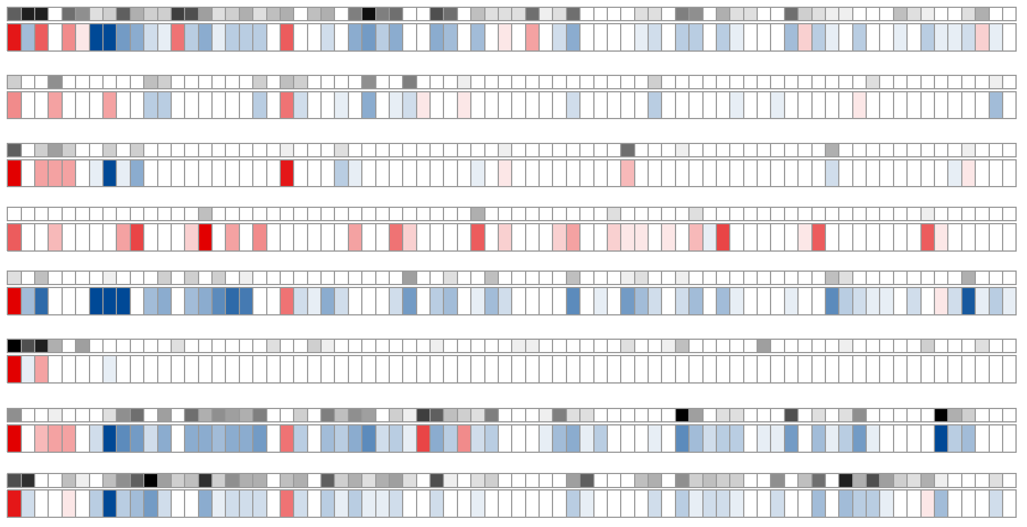
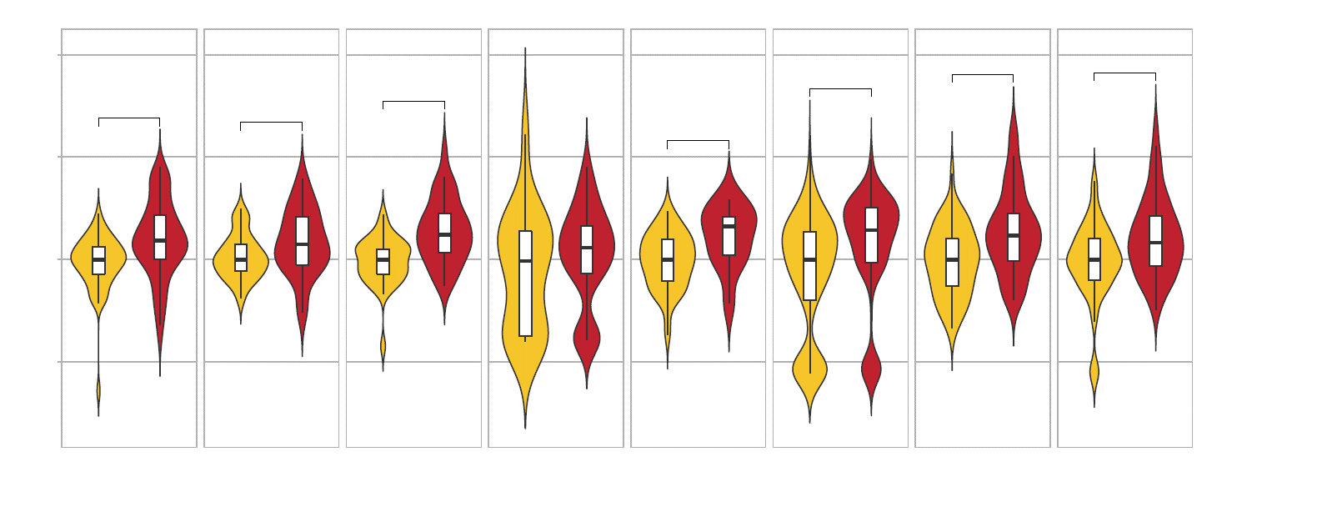
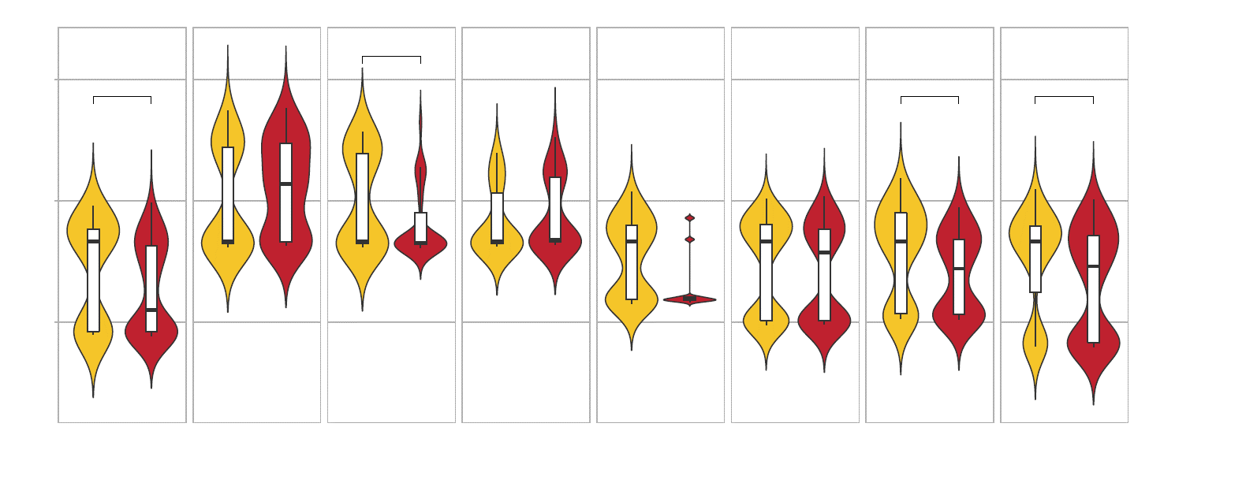
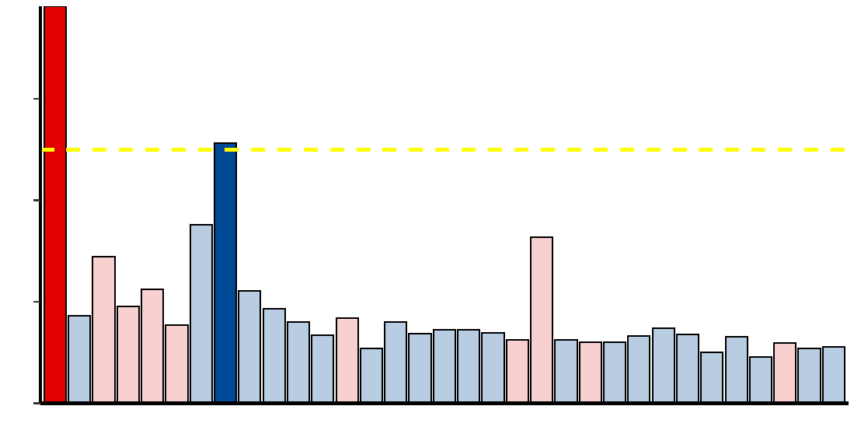
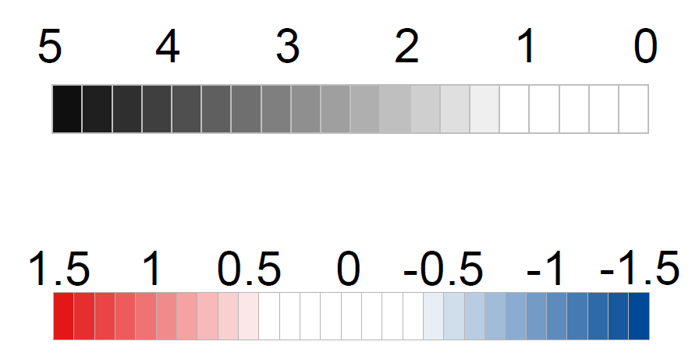
Figure 1
Fungal features selection
(control vs. CRC)
a
17.0
7.5
17.0
- log₁₀ FDR
7.5
- log₁₀ FDR
5.0
5.0
2.5
FDR < 0.1
2.5
0.0
FDR < 0.01
b
0.0
d
Aspergillus rambellii
2014_ZellerG
(EU)
1e+04
2.6e-04
0.017
1.3e-04
4.4e-07
1.3e-03
1.2e-04
2015_FengQ
(OC)
1e+02
0.018
2016_VogtmannE
(NA)
1e+00
2019_ThomasAM
(EU)
1e-02
2019_WirbelJ
(EU)
Aspergillus kawachii
1e+04
0.016
0.012
0.02
0.006
2019_YachidaS
(AS)
2017_YuJ
(AS)
1e+01
2021_ YuJ
(AS)
1e-02
Aspergillus rambellii
Rhizophagus irregularis
Moniliophthora perniciosa
Erysiphe pulchra
Sphaerulina musiva
Phytophthora capsici
Trichophyton mentagrophytes
Aspergillus kawachii
Pneumocystis murina
Debaryomyces hansenii
Trichoderma atroviride
Pseudocercospora musae
Cordyceps sp. RAO−2017
Rhizophagus clarus
Pichia kudriavzevii
Paracoccidioides brasiliensis
Albugo candida
Lipomyces starkeyi
Naumovozyma dairenensis
Phytopythium vexans
Aspergillus ochraceoroseus
Colletotrichum fioriniae
Coniochaeta ligniaria
Leucoagaricus sp. SymC.cos
Colletotrichum salicis
[Candida] arabinofermentans
Baudoinia panamericana
Hyaloscypha variabilis
Schizosaccharomyces pombe
Tuber magnatum
Thielaviopsis punctulata
Edhazardia aedis
Choanephora cucurbitarum
2014_ZellerG
(EU)
2015_FengQ
(OC)
2019_WirbelJ
(EU)
2019_YachidaS
(AS)
2017_YuJ
(AS)
2021_ YuJ
(AS)
2016_VogtmannE
(NA)
2019_ThomasAM
(EU)
c
- log₁₀(p value)
abs( log₂ FC )
1.2
abs( log₂ FC ) > 1.0
0.8
log₂(Fold change)
0.4
0.0
CRC Enriched
CRC Depleted

